Slide 1
Program 4 Hashing

Slide 2
Understand Hash Table code given to you
Modify so declarations takes two arguments: type of key and record.
Test so you can tell everything works.

Slide 3
Create poetry based on word frequencies
A bi-word model of English consists of two probability distributions: P(W) and P(W_{i+1} | W_{i}). The first distribution is just the probability a word in a document. The second distribution is the probability of seeing word W_{i+1} given that the previous word was W_{i}.
Given a word, you find the next word based on probabilities

Slide 4
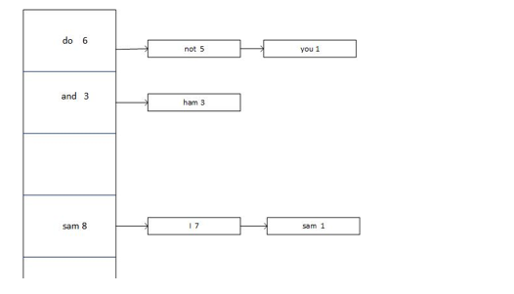
Structure for entries in hash table are given
I am Sam. I am Sam. Sam I Am.
That Sam I Am! That Sam I Am! I do not like that Sam I Am!
Do you like green eggs and ham?
I do not like them, Sam I Am.
I do not like green eggs and ham.
Would you like them here or there?
I would not like them here or there.
I would not like them anywhere.
I do not like green eggs and ham.
I do not like them, Sam I Am.

Slide 5
public static class Freq {
String follow;
int followCt;
public Freq(String follow, int ct) {
this.follow = follow;
this.followCt = ct;
}
  public String toString() {
  return follow + " [" + followCt + "] ";
  }
  public boolean equals(Freq f2) {
  return this.follow.equals(f2.follow);
  }
}

Slide 6
public class WordFreqInfo {
public String word;
public int occurCt;
ArrayList<Freq> followList;
  public WordFreqInfo(String word, int count) {
    this.word = word;
    this.occurCt = count;
    this.followList = new ArrayList<Freq>();
  }
  public void updateFollows(String follow) {
    boolean updated = false;
    //System.out.println("updateFollows " + word + " " + follow);
    for (Freq f : followList) {
      if (follow.compareTo(f.follow) == 0) {
        f.followCt++;
        updated = true;
      }
  }
  if (!updated)
  followList.add(new Freq(follow, 1));
  }

